Slide 1
AQMEII 4 Deposition:
Current Status of the Fourth Phase of the Air Quality Model Evaluation International Initiative
Presenter: Paul Makar, Environment and Climate Change Canada
^{NADP meeting, May 11, 2021}

Slide 2
Acknowledgments
Chairs:
Stefano Galmarini (EC-JRC, Italy) and Christian Hogrefe (USEPA, USA)
Scientific Committee:
Johannes Bieser (GKSS, Germany), Olivia Clifton (UCAR, USA), Jason Ducker (FSU, USA), Lisa Emberson (SEI, University of York, UK), Johannes Flemming (ECMWF, UK), Christopher Holmes (FSU, USA), Paul Makar (ECCC, Canada), Martijn Schaap (TNO, Netherlands), Donna Schwede (USEPA, USA), Sam Silva (MIT, USA)
Contributors:
Jesse Bash (USEPA, USA), Roberto Bellasio (Enviroware), Roberto Bianconi (Enviroware), Tim Butler (IASS, Germany), Mhairi Coyle (UKCEH/JHI, UK), Erick Fredj (JCT, Israel), Ignacio Goded (JRC, Italy), Oresis Gazetas (JRC, Italy), Alma Hodzic (NCAR, USA), László Horváth (Greengrass, Hungary), Richard Kranenburg (TNO), Ioannis Kioutsioukis (U. Patras), Qian Li (HUJ, Israel), Aurelia Lupascu (IASS, Germany), Ivan Mammarella (U.Helsinki, Finland), Giovanni Manca, JRC, Italy), J.W. Munger (Harvard U, USA), Juan Luis Perez-Camanyo (UPM, Spain), Jonathan Pleim (EPA, USA), Young-Hee Ryu (POSTECH, South Korea), Roberto San Jose (UPM, Spain), Ralf Staebler (ECCC, Canada), Eran Tas (HUJ, Israel), Marta Garcia Vivanco (CIEMAT, Spain), Ralf Wolke (LITR, Germany)

Slide 3
Motivation and Goals of AQMEII-4
Motivation:
Deposition remains a crucial process in the species budget of any AQ model yet has not been systematically evaluated across multiple regional AQ modeling systems
Past studies typically focused on specific modeling systems and depositions totals
No systematic analysis exists of the individual and combined impacts of different representations of resistances, deposition media, land use, and meteorological conditions, on simulated total deposition
Goals of AQMEII Phase 4:
Assess in detail the deposition processes in regional scale models:
Diagnostic evaluation
Investigate the reasons for differences
Impact of different land types and land type databases
Assess the variability of deposition estimates produced by the community relative to common, aggregated, land use types
Assess the different methodologies describing deposition pathways into and onto vegetation
Assess the range of variability for estimated critical loads and critical load exceedances

Slide 4
Two Main Activities in AQMEII-4: Activity 1
Two full years of simulations are required from all participants.
Continental Europe: 2009 and 2010
Continental North America: 2010 and 2016
AQMEII provided a common set of input emissions fields and lateral chemical boundary conditions.
Meteorological fields have been / are being simulated by each group.
Grids:
Models operate on their “native” resolution.
The gridded results are amalgamated and submitted on a common latitude/longitude grid with a grid spacing of 0.125 degrees.
Recommendation: chose a native grid resolution that is comparable to this target resolution.
Participants will also submit model output at a specified set of monitoring locations.
Diagnostics requested profile the gas-phase deposition algorithms in detail.

Slide 5
AQMEII-4 Activity 1 Participating Regional Modelling Groups
Content
Group/Institution | Model | Cases modeled
TROPOS Leipzig | COSMO / MUSCAT | EU
Environment and Climate Change Canada | GEM / MACH (3 different configurations) | NA
Technical University of Madrid (UPM) | WRF-Chem | EU NA
TNO | LOTOS / EUROS | EU
IASS | WRF-Chem | EU NA
US-EPA | WRF / CMAQ (2 different configurations) | NA
GKSS | COSMO-CLM / CMAQ | EU NA
NCAR | WRF-Chem | NA
Univ. Hertfordshire | WRF / CMAQ | EU
CIEMAT | ECMWF/IFS / CHIMERE | EU

Slide 6
Two Main Activities in AQMEII-4: Activity 2
ACT2. Point Intercomparison Runs
Point (i.e. box model or zero-dimensional) intercomparison.
Participants will be asked to calculate dry deposition velocity and of diagnostics for a suite of gases and particles under prescribed surface and atmospheric conditions.
The goal is to reveal and understand the variation in dry deposition velocities between multiple models under identical environmental conditions as well as the implications for air quality:
Control simulation:
AQMEII4 provides hourly meteorological and environmental data at six locations (eddy flux towers) as box model inputs.
A “wrapper code” (courtesy D. Schwede) is provided - participants use these data and their deposition codes within the wrapper code to calculate and submit the resulting dry deposition velocities.
These will be intercompared and evaluated against available deposition velocity measurements, focus on O₃.
Perturbation simulations:
May include, e.g., changes in surface type, leaf area, surface wetness, soil moisture, humidity, and other meteorological variables.

Slide 7
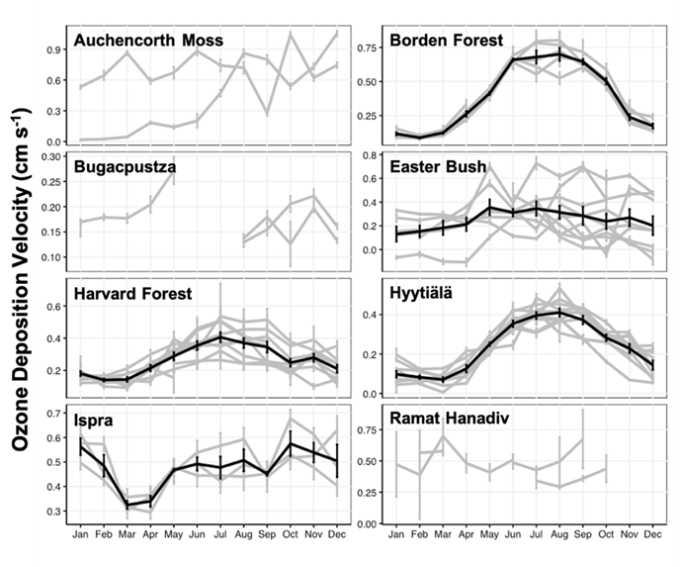
AQMEII-4 Activity 2 Observation Sites
Monthly mean observed ozone deposition velocities.
Individual years are grey, black indicates average for sites with >= 3years of data
Site | Location | Vegetation Type
Auchencorth Moss | Central Scotland | Peat bog covered with heather, moss and grass
Borden Forest | Southeastern Canada | Mixed deciduous and coniferous boreal-temperate transition forest
Bugacpuszta | Hungary | Semi-natural, semi-arid grassland, grazing (perennial fescue, etc.)
Easter Bush | Central Scotland | Grassland, silage harvest and grazing (perennial ryegrass)
Ispra | Northern Italy | Temperate broadleaf forest (oak, alder)
Harvard Forest | Northeastern USA | Deciduous broadleaf forest (oak, maple), local coniferous
Hyytiälä | Southern Finland | Pine forest, lingonberry, moss undergrowth
Ramat Hanadiv | Near-Coastal Israel | Oak, evergreen shrubs (pistacia), cypress, etc.
Clifton et al., 2021, in prep.

Slide 8
AQMEII-4 Activity 2 Measured or Inferred Variables to drive Deposition
Atmospheric variables | Surface properties and variables
CO₂ mole fraction Air temperature Air pressure Relative humidity Incoming shortwave radiation Photosynthetically active radiation Net radiation Wind speed Wind direction Friction velocity Sensible heat flux Precipitation rate | Land cover/land use type Vegetation composition Soil type Leaf wetness Snow depth Soil moisture near surface Soil moisture in root zone Soil temperature near surface Leaf area index Canopy height Measurement height
Clifton et al., 2021, in prep.

Slide 9
AQMEII-4 Activity 2 Simulations
Simulation | Conditions
Base | Use inputs as measured
Cloudy | Reduce solar radiation and photosynthetically active radiation by 50%
Night | Set solar radiation and photosynthetically active radiation to zero
Wet | Set leaf wetness (fractional) to 1
Dry | Set leaf wetness (fractional) to 0
Snow | Set snow cover (fractional) to 1
Hot | Increase air temperature 10 K
Cold | Decrease air temperature 10 K
Humid | Increase relative humidity 30%
Dry | Decrease relative humidity 30%
Windy | Increase wind speed 5 m s^{–1}
Stagnant | Decrease wind speed 5 m s^{–1}
Soil-Wet | Set soil moisture to field capacity
Soil-Dry | Set soil moisture to 30% of field capacity
Soil-Hot | Increase soil temperature 5 K
Soil-Cold | Decrease soil temperature 5 K
LAI+40 | Increase LAI 40%
LAI-40 | Decrease LAI 40%
LULC-Activity1 | Set LULC type to the type used at the site in the regional model, which may differ from the actual type
Clifton et al., 2021, in prep.

Slide 10
Activity 1 Protocol
Identification of the variables to be requested was a key issue
The steering group conducted a 1.5 year analysis to determine the variables to be reported, and how to report them.
This analysis included:
Harmonization of the nomenclatures:
Ensure a specific definition of a resistance or conductance would comprise the same processes across different models, since no common nomenclature existed in general and across schemes
Harmonizing the reported land use categories:
Deposition diagnostics are reported on common AQMEII4 land use categories.
Determining which variables and parameters best represent equivalent deposition-related pathways,
Across models with different deposition formulations.
The formula required for some reported parameters (effective conductance, effective fluxes) are model-specific.

Slide 11
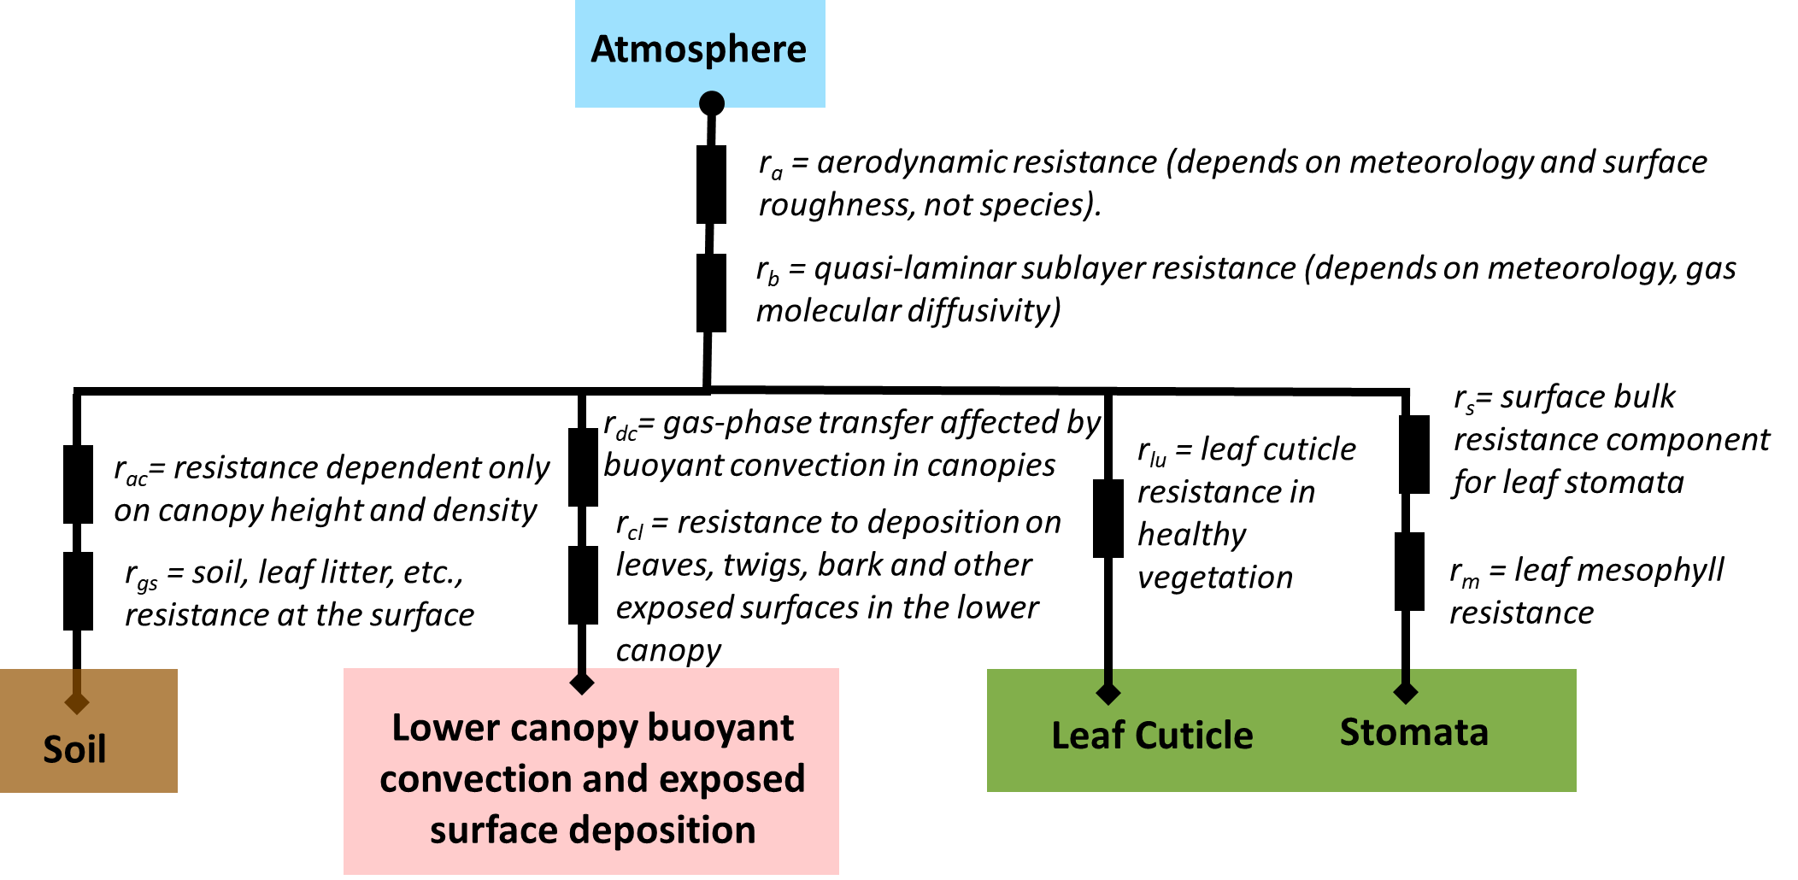
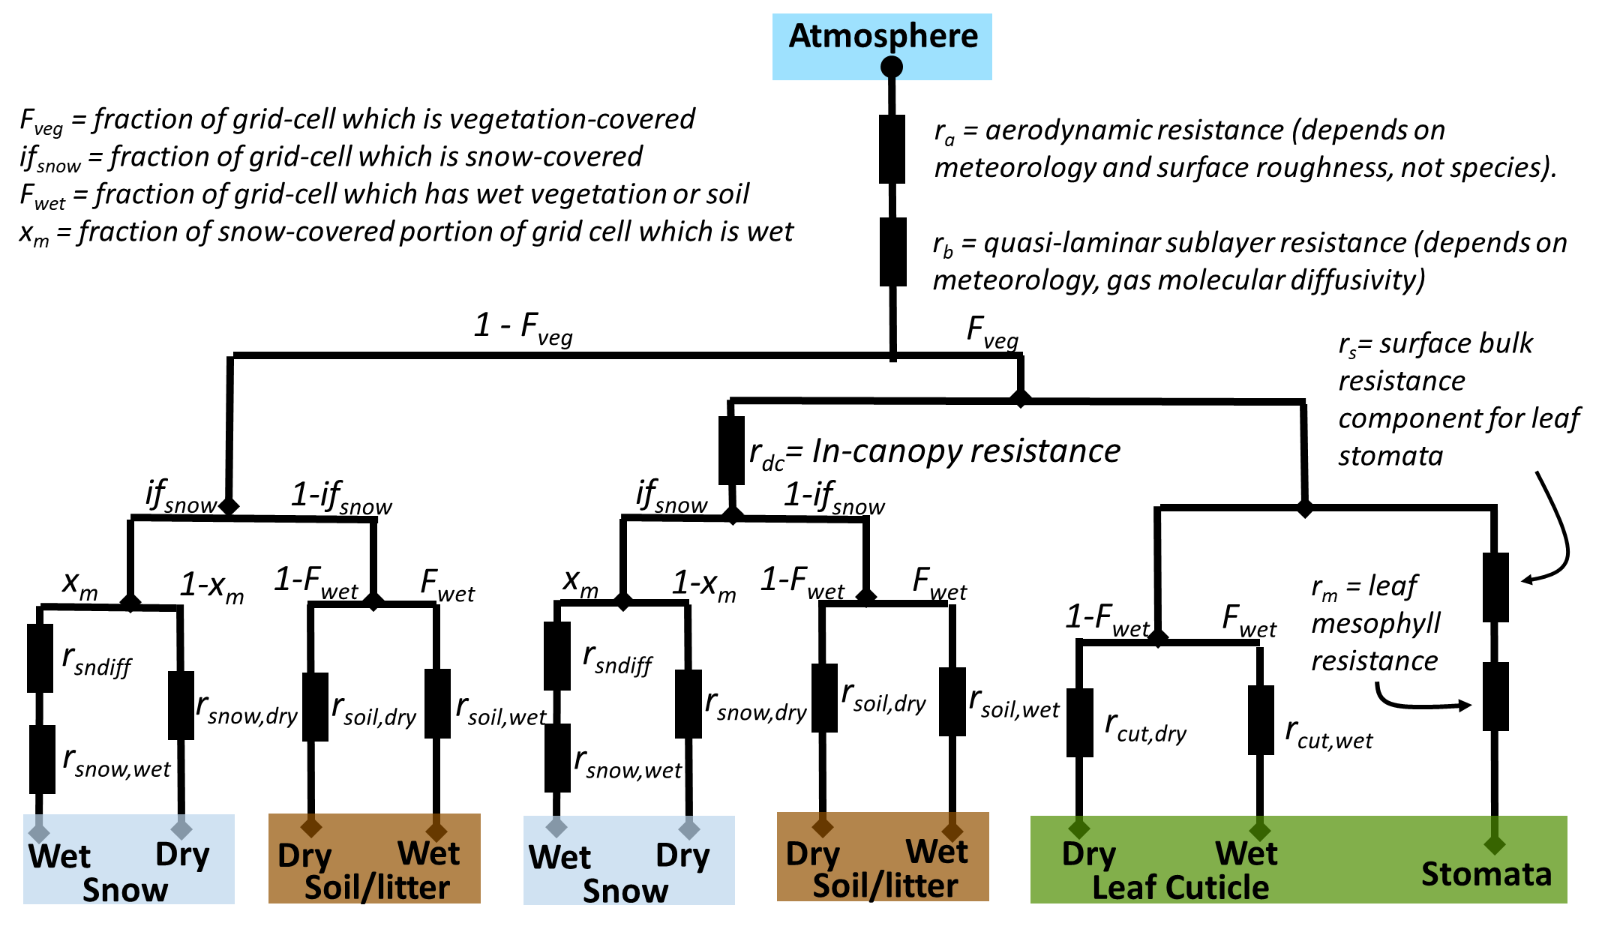
Cross-comparing gas deposition algorithms can be difficult!
While models have some resistance terms in common, the details vary considerably.
Despite these differences between different resistance formulations, common deposition pathways may be compared using the concept of effective conductance, and an associated diagnostic, the effective flux.
An effective conductance is the contribution of a given depositional pathway to the deposition velocity, in the same units as the deposition velocity.
An effective flux is the contribution of a given depositional pathway to the flux, in the same units as the flux. (= Flux * effective conductance / deposition velocity)
CMAQ/M3DRY
GEM-MACH

Slide 12
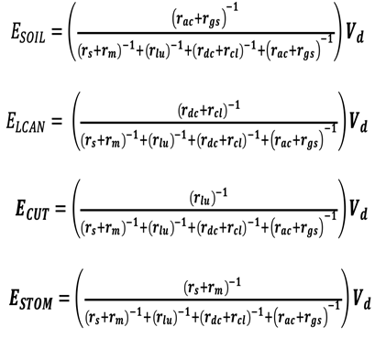
Effective Conductances
The effective conductances of the soil, lower canopy, cuticle and stomata branches specifically for Wesely (1989) are shown below
The denominator in each of the equations is the inverse of the bulk surface resistance r_{c}, while the numerators are the inverses of the resistances associated with each pathway of the bulk surface resistance.
Their formulation thus differs between models: AQMEII4 has provided examples in the participant documentation.
Once calculated, they are an invaluable tool for determining which deposition pathways for surface resistance drive net deposition, as well as intermodel, spatial, and temporal variability.

Slide 13
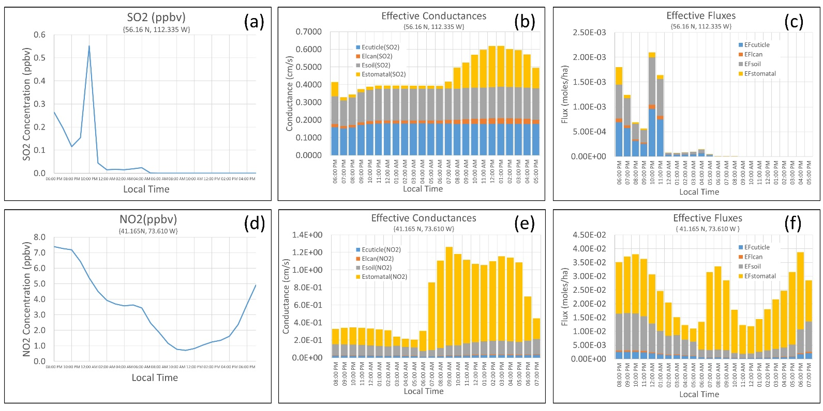
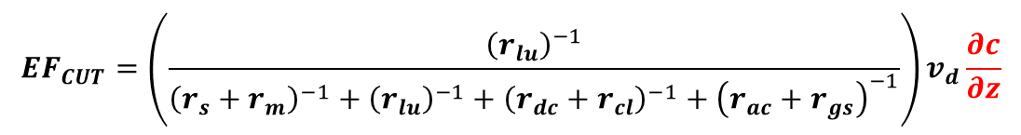
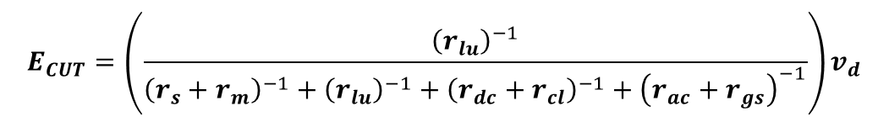
Effective Conductances vs Effective Fluxes
Effective Conductance: contribution of the pathway towards deposition velocity
$$E_{CUT}=\left(\frac{{\left(r_{lu}\right)}^{−1}}{{\left(r_{s}+r_{m}\right)}^{−1}+{\left(r_{lu}\right)}^{−1}+{\left(r_{dc}+r_{cl}\right)}^{−1}+{\left(r_{ac}+r_{gs}\right)}^{−1}}\right)v_{d}$$
Effective Flux: contribution of the pathway towards deposition flux
$${EF}_{CUT}=\left(\frac{{\left(r_{lu}\right)}^{−1}}{{\left(r_{s}+r_{m}\right)}^{−1}+{\left(r_{lu}\right)}^{−1}+{\left(r_{dc}+r_{cl}\right)}^{−1}+{\left(r_{ac}+r_{gs}\right)}^{−1}}\right)v_{d}\frac{∂c}{∂z}$$
The time-varying magnitude of the concentration gradient can influence the relative importance of the pathways towards deposition flux.

Slide 14
AQMEII-4 Activity 1 Chemical Species Reported
Gases:
SO₂, NO₂, NO, HNO₃, NH₃, PAN, HNO₄, N₂O₅, organic nitrates, O₃, H₂O₂ and HCHO
Dry deposition reported across each grid cell and/or receptor, for each of 16 AQMEII4 land use types, as well as for the net values
Effective dry deposition conductances and process-specific resistance terms held in common by most models, both net and by AQMEII4 land use type
Net wet deposition for these gases
Particles: net dry flux for particle sulphate, nitrate, ammonium, total carbon, elemental carbon, base cations, sea-salt, crustal material, PM2.5
Ions: wet fluxes (eq ha⁻¹) of HSO₃⁻, SO₄⁼, NO₃⁻, NH₄⁺, base cations, TOC, precipitation

Slide 15
AQMEII-4 Activity 1 Gas-Phase Diagnostics
A survey of the various deposition schemes used by the participating models has led to requesting this specific list of variables for gas dry deposition
Name | AQMEII4 variable | Name of diagnostic
r_{a} | RES_AERO | Aerodynamic resistance
r_{c} | RES_SURF | Bulk surface resistance
r_{s} | RES_STOM | Net stomatal resistance
r_{m} | RES_MESO | Net mesophyll resistance
r_{c} | RES_CUT | Net cuticle resistance
E_{STOM} | ECOND_ST | Effective conductance associated with deposition to plant stomata
E_{CUT} | ECOND_CUT | Effective conductance associated with deposition to plant cuticles
E_{SOIL} | ECOND_SOIL | Effective conductance associated with deposition to soil and un-vegetated surfaces
E_{LCAN} | ECOND_LCAN | Effective conductance associated with deposition to the lower canopy.
r_{b, stom} | RES_QLSB_STOM | Quasi-laminar sublayer resistance associated with stomatal pathway (= r_{b} if this is pathway-independent for the deposition framework)
r_{b,cut} | RES_QLSB_CUT | Quasi-laminar sublayer resistance associated with cuticle pathway (= r_{b} if this is pathway-independent for the deposition framework)
r_{b,soil} | RES_QLSB_SOIL | Quasi-laminar sublayer resistance associated with soil pathway (= r_{b} if this is pathway-independent for the deposition framework)
r_{b,lcan} | RES_QLSB_LCAN | Quasi-laminar sublayer resistance associated with lower canopy pathway (= r_{b} if this is pathway-independent for the deposition framework)
EF_{lcan} | DFLX_LCAN | Effective Flux for lower canopy pathway
EF_{stom} | DFLX_ST | Effective Flux for stomatal pathway
EF_{cut} | DFLX-CUT | Effective Flux for cuticle pathway
EF_{soil} | DFLX-SOIL | Effective Flux for soil pathway

Slide 16
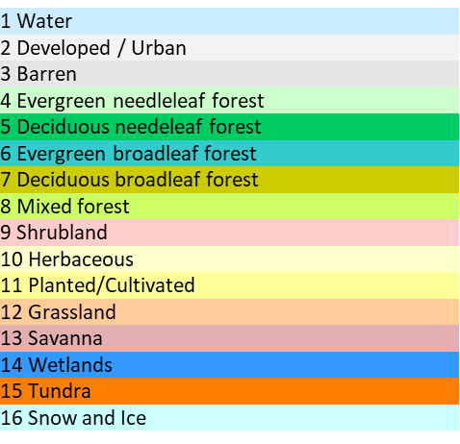
AQMEII-4 Activity 1 Land Use Reporting
Every participating model has its own land use scheme (below)
A 16 classes scheme for AQMEII4 has been devised, into which the individual model classes must be lumped (right) (colour-coded)
1 Water Bodies | 1 Water | 1 Water Bodies | 1 Water Bodies | 1 high intensity residential | 1 Water | 1 Water Bodies | 1 CF: Temperate coniferous forests | 1: Developed / Urban | 1 Water bodies | 1 Water | 1 Agricultural land/crops | 1 Inland water | 1 Water (Ocean) | 1 Evergreen Needleleaf Forest | 1 Water Bodies | 1 W: Water | 1 Evergreen Needleleaf Forest | 1 Water Bodies | 1 Water (Ocean) | 1 Sea | 1 Water (Ocean) | 1 Water
2 Urban and Built-Up Land | 2 Urban and Built-Up | 2 Urban and Built-Up Land | 2 Urban and Built-Up Land | 2 low intensity residential | 2 Urban and Built-Up | 2 Urban and Built-Up Land | 2 DF: Temperate deciduous forests | 2: Dryland Cropland and Pasture | 2 Ocean | 2 Inland lake | 2 Grassland | 2 Desert | 2 Inland Lake (Fresh) | 2 Evergreen Broadleaf Forest | 2 Urban and Built-Up Land | 2 U: Urban | 2 Evergreen Broadleaf Forest | 2 Urban and Built-Up Land | 2 Inland Lake (Fresh) | 2 Water | 2 Inland Lake (Fresh) | 2 Urban and Built-Up
3 Bare Ground Tundra | 3 Barren Tundra | 3 Bare Ground Tundra | 3 Bare Ground Tundra | 3 commercial, industry, transport | 3 Barren Tundra | 3 Bare Ground Tundra | 3 NF: Mediterranean needleleaf forests | 3: Irrigated Cropland and Pasture | 3 Artificial surfaces | 3 Inland water | 3 Barren land/bare ground | 3 Evergreen needle-leaf forest | 3 Urban | 3 Deciduous Needleleaf Forest | 3 Bare Ground Tundra | 3 DE: Desert | 3 Deciduous Needleleaf Forest | 3 Bare Ground Tundra | 3 Urban | 3 Town | 3 Urban | 3 Barren Tundra
4 Barren or Sparsely Vegetated | 4 Barren or Sparsely Vegetated | 4 Barren or Sparsely Vegetated | 4 Barren or Sparsely Vegetated | 4 irrigated cropland and pasture | 4 Barren or Sparsely Vegetated | 4 Barren or Sparsely Vegetated | 4 BF: Mediterranean broadleaf forests | 4: Mixed Dryland/Irrigated Cropland and Pasture | 4 Open space with little or no vegetation | 4 Urban | 4 Inland Water | 4 Deciduous needle-leaf forest | 4 Desert | 4 Deciduous Broadleaf Forest | 4 Barren or Sparsely Vegetated | 4 BARE | 4 Deciduous Broadleaf Forest | 4 Barren or Sparsely Vegetated | 4 Desert | 4 Bare soil | 4 Desert | 4 Barren or Sparsely Vegetated
5 Evergreen Needleleaf Forest | 5 Evergreen Needleleaf Forest | 5 Evergreen Needleleaf Forest | 5 Evergreen Needleleaf Forest | 5 cropland/woodland mosaic | 5 Evergreen Needleleaf Forest | 5 Evergreen Needleleaf Forest | 5 TC: Temperate crops | 5: Cropland/Grassland Mosaic | 5 Evergreen needleleaf forest | 5 Urban and built-up | 5 Urban | 5 Evergreen broadleaf forest | 5 Evergreen needleleaf trees | 5 Mixed Forest | 5 Evergreen Needleleaf Forest | 5 CF: Temperate coniferous forests | 5 Mixed Forest | 5 Evergreen Needleleaf Forest | 5 Evergreen needleleaf trees | 5 Bare rock | 5 Evergreen needleleaf trees | 5 Evergreen Needleleaf Forest
6 Deciduous Needleleaf Forest | 6 Deciduous Needleleaf Forest | 6 Deciduous Needleleaf Forest | 6 Deciduous Needleleaf Forest | 6 Dryland cropland and pasture | 6 Deciduous Needleleaf Forest | 6 Deciduous Needleleaf Forest | 6 MC: Mediterranean crops | 6: Cropland/Woodland Mosaic | 6 Deciduous needeleaf forest | 6 Desert | 6 Shrubs | 6 Deciduous broadleaf forest | 6 Deciduous needleleaf trees | 6 Closed Shrublands | 6 Deciduous Needleleaf Forest | 6 NF: Mediterranean needleleaf forests | 6 Shrublands | 6 Deciduous Needleleaf Forest | 6 Deciduous needleleaf trees | 6 Boreal needleleaf evergreen | 6 Deciduous needleleaf trees | 6 Deciduous Needleleaf Forest
7 Evergreen Broadleaf Forest | 7 Evergreen Broadleaf Forest | 7 Evergreen Broadleaf Forest | 7 Evergreen Broadleaf Forest | 7 herbaceous wetland | 7 Evergreen Broadleaf Forest | 7 Evergreen Broadleaf Forest | 7 RC: Root crops | 7: Grassland | 7 Evergreen broadleaf forest | 7 Evergreen needleleaf trees | 7 Needleaf forest | 7 Mixed Forest | 7 Evergreen broadleaf trees | 7 Open Shrublands | 7 Evergreen Broadleaf Forest | 7 NDLF-EVGN-BORL-TREE | 7 Savanna | 7 Evergreen Broadleaf Forest | 7 Evergreen broadleaf trees | 7 Temperate needleleaf evergreen | 7 Evergreen broadleaf trees | 7 Evergreen Broadleaf Forest
8 Deciduous Broadleaf Forest | 8 Deciduous Broadleaf Forest | 8 Deciduous Broadleaf Forest | 8 Deciduous Broadleaf Forest | 8 Deciduous broadleaf forest | 8 Deciduous Broadleaf Forest | 8 Deciduous Broadleaf Forest | 8 SNL: Seminatural/Moorland | 8: Shrubland | 8 Deciduous broadleaf forest | 8 Deciduous needleleaf trees | 8 Broadleaf forest | 8 Crops | 8 Tropical broadleaf trees | 8 Woody Savanna | 8 Deciduous Broadleaf Forest | 8 NDLF-EVGN-TMPT-TREE | 8 Grasslands | 8 Deciduous Broadleaf Forest | 8 Tropical broadleaf trees | 8 Boreal needeleaf cold-deciduous | 8 Tropical broadleaf trees | 8 Deciduous Broadleaf Forest
9 Mixed Forest | 9 Mixed Forests | 9 Mixed Forest | 9 Mixed Forest | 9 Evergreen needle leaf forest | 9 Mixed Forests | 9 Mixed Forest | 9 GR: Grassland | 9: Mixed Shrubland/Grassland | 9 Mixed forest | 9 Evergreen broadleaf trees | 9 Ocean | 9 Crops, mixed farming | 9 Deciduous broadleaf trees | 9 Savanna | 9 Mixed Forest | 9 NDLF-DECD-BORL-TREE | 9 Dryland Cropland and Pasture | 9 Mixed Forest | 9 Deciduous broadleaf trees | 9 Tropical broadleaf evergreen | 9 Deciduous broadleaf trees | 9 Mixed Forests
10 Shrubland | 10 Closed Shrublands | 10 Shrubland | 10 Shrubland | 10 Mixed forest | 10 Closed Shrublands | 10 Shrubland | 10 MS: Mediterranean scrub | 10: Savanna | 10 Artificial non-agraic. vegetated ares (green urban area) | 10 Tropical broadleaf trees |  | 10 Long grass | 10 Drought deciduous trees | 10 Grasslands | 10 Shrubland | 10 BF: Mediterranean broadleaf forest | 10 Irrigated Cropland and Pasture | 10 Shrubland | 10 Drought deciduous trees | 10 Temperate broadleaf evergreen | 10 Drought deciduous trees | 10 Closed Shrublands
11 Herbaceous Wetland | 11 Open Shrublands | 11 Herbaceous Wetland | 11 Herbaceous Wetland | 11 Grassland | 11 Open Shrublands | 11 Herbaceous Wetland | 11 WE: Wetlands | 11: Deciduous broadleaf forest | 11 Agro-forestry area | 11 Deciduous broadleaf trees |  | 11 Grassland | 11 Mixed Wood Forest | 11 Permanent Wetlands | 11 Herbaceous Wetland | 11 BDLF-EVGN-TROP-TREE | 11 Cropland/Grassland Mosaic | 11 Herbaceous Wetland | 11 Mixed Wood Forest | 11 Temperate broadleaf cold-deciduous | 11 Mixed Wood Forest | 11 Open Shrublands
12 Dryland Cropland and Pasture | 12 Croplands | 12 Dryland Cropland and Pasture | 12 Dryland Cropland and Pasture | 12 Mixed shrubland/grassland | 12 Croplands | 12 Dryland Cropland and Pasture | 12 TU: Tundra | 12: Deciduous needeleaf forest | 12 Transitional woodland-shrub | 12 Drought deciduous trees |  | 12 Wetland with plants | 12 Transitional Forest | 12 Croplands | 12 Dryland Cropland and Pasture | 12 BDLF-EVGN-TMPT-TREE | 12 Urban and Built-up | 12 Dryland Cropland and Pasture | 12 Transitional Forest | 12 Tropical broadleaf deciduous | 12 Transitional Forest | 12 Croplands
13 Irrigated Cropland and Pasture | 13 Cropland / Natural Vegetation Mosaic | 13 Irrigated Cropland and Pasture | 13 Irrigated Cropland and Pasture | 13 Barren or sparsely vegetated | 13 Cropland / Natural Vegetation Mosaic | 13 Irrigated Cropland and Pasture | 13 DE: Desert | 13: Evergreen broadleaf forest | 13 Moors and heathland | 13 Mixed wood forests |  | 13 Dwarf trees, shrubs | 13 Evergreen broadleaf shrubs | 13 Urban and Built-up | 13 Irrigated Cropland and Pasture | 13 DF: Temperate deciduous forests | 13 Mixed Dryland/Irrigated Cropland and Pasture | 13 Irrigated Cropland and Pasture | 13 Evergreen broadleaf shrubs | 13 Boreal broadleaf cold-deciduous | 13 Evergreen broadleaf shrubs | 13 Cropland / Natural Vegetation Mosaic
14 Mixed Dryland/Irrigated Cropland and Pasture | 14 Woody Savannas | 14 Mixed Dryland/Irrigated Cropland and Pasture | 14 Mixed Dryland/Irrigated Cropland and Pasture | 14 snow or ice | 14 Woody Savannas | 14 Mixed Dryland/Irrigated Cropland and Pasture | 14 W: Water | 14: Evergreen needleleaf forest | 14 Non-irrigated arable land | 14 Transitional forest |  | 14 Tundra | 14 Deciduous shrubs | 14 Cropland-Natural Vegetation Mosaic | 14 Mixed Dryland/Irrigated Cropland and Pasture | 14 BDLF-DECD-BORL-TREE | 14 Cropland/Woodland Mosaic | 14 Mixed Dryland/Irrigated Cropland and Pasture | 14 Deciduous shrubs | 14 Mixed forest | 14 Deciduous shrubs | 14 Woody Savannas
15 Cropland/Grassland Mosaic | 15 Savannas | 15 Cropland/Grassland Mosaic | 15 Cropland/Grassland Mosaic | 15 inland water bodies | 15 Savannas | 15 Cropland/Grassland Mosaic | 15 I: Ice | 15: Mixed forest | 15 Permanentaly irrigated land | 15 Evergreen broadleaf shrub |  | 15 Ice caps and glaciers | 15 Thorn shrubs | 15 Snow and Ice | 15 Cropland/Grassland Mosaic | 15 BDLF-DECD-TMPT-TREE | 15 Snow or Ice | 15 Cropland/Grassland Mosaic | 15 Thorn shrubs | 15 Shrub | 15 Thorn shrubs | 15 Savannas
16 Cropland/Woodland Mosaic | 16 Grasslands | 16 Cropland/Woodland Mosaic | 16 Cropland/Woodland Mosaic | 16 water bodies | 16 Grasslands | 16 Cropland/Woodland Mosaic | 16 U: Urban | 16: Water | 16 Rice fields | 16 Deciduous shrubs |  |  | 16 Rice | 16 Barren or Sparsely Vegetated | 16 Cropland/Woodland Mosaic | 16 BDLF-DECD-TROP-TREE | 16 Barren or Sparsely Vegetated | 16 Cropland/Woodland Mosaic | 16 Rice | 16 Winter crops | 16 Rice | 16 Grasslands
17 Grassland | 17 Permanent Wetlands | 17 Grassland | 17 Grassland | 17 unclassified | 17 Permanent Wetlands | 17 Grassland |  | 17: Herbacious Wetland | 17 Vineyards | 17 Thorn shrubs |  |  | 17 Sugar | 17 water | 17 Grassland | 17 MS: Mediterranean scrub | 17 Water | 17 Grassland | 17 Sugar | 17 Summer crops | 17 Sugar | 17 Permanent Wetlands
18 Mixed Shrubland/Grassland | 18 Wooded Tundra | 18 Mixed Shrubland/Grassland | 18 Mixed Shrubland/Grassland |  | 18 Wooded Tundra | 18 Mixed Shrubland/Grassland |  | 18: Wooden Wetland | 18 Fruit trees and berry plantations | 18 Crops |  |  | 18 Maize | 18 Perrenial Ice/snow | 18 Mixed Shrubland/Grassland | 18 BDLF-EVGN-SHRB | 18 Mixed Forest | 18 Mixed Shrubland/Grassland | 18 Maize | 18 Irrigated crops | 18 Maize | 18 Wooded Tundra
19 Savanna | 19 Mixed Tundra | 19 Savanna | 19 Savanna |  | 19 Mixed Tundra | 19 Savanna |  | 19: Barren or sparsely vegetated | 19 Olive groves | 19 Ice |  |  | 19 Cotton | 19 Developed open space | 19 Savanna | 19 BDLF-DECD-BORL-SHRB | 19 Herbaceous Tundra | 19 Savanna | 19 Cotton | 19 Irrigated grass | 19 Cotton | 19 Mixed Tundra
20 Wooded Wetland | 20 Snow and Ice | 20 Wooded Wetland | 20 Wooded Wetland |  | 20 Snow and Ice | 20 Wooded Wetland |  | 20: Herbaceous Tundra | 20 Pastures | 20 Sugar |  |  | 20 Irrigated crops | 20 Developed Low Intensity | 20 Wooded Wetland | 20 BDLF-DECD-TMPT-SHRB | 20 Wooded Tundra | 20 Wooded Wetland | 20 Irrigated crops | 20 Grassland | 20 Irrigated crops | 20 Snow and Ice
21 Herbaceous Tundra |  | 21 Herbaceous Tundra | 21 Herbaceous Tundra |  |  | 21 Herbaceous Tundra |  | 21: Wooded Tundra | 21 Annual crops associated with permanent crops | 21 Maize |  |  | 21 Short grass and forbs | 21 Developed Medium Intensity | 21 Herbaceous Tundra | 21 SNL: Seminatural/Moorland | 21 Mixed Tundra | 21 Herbaceous Tundra | 21 Crops | 21 Savana / Tropical grassland | 21 Crops
22 Wooded Tundra |  | 22 Wooded Tundra | 22 Wooded Tundra |  |  | 22 Wooded Tundra |  | 22: Mixed Tundra | 22 Complex cultivation patterns | 22 Cotton |  |  | 22 Swamp | 22 Developed High Intensity | 22 Wooded Tundra | 22 TC: Temperate crops | 22 Bareground Tundra | 22 Wooded Tundra | 22 Short grass and forbs | 22 Wetlands | 22 Short grass and forbs
23 Mixed Tundra |  | 23 Mixed Tundra | 23 Mixed Tundra |  |  | 23 Mixed Tundra |  | 23: Bare ground Tundra | 23 Agriculture and natural vegetation | 23 Irrigated crops |  |  | 23 Tundra | 23 Barren Land | 23 Mixed Tundra | 23 MC: Mediterranean crops | 23 Wooden Wetland | 23 Mixed Tundra | 23 Long grass | 23 Tundra / Boreal grass | 23 Long grass
24 Snow or Ice |  | 24 Snow or Ice | 24 Snow or Ice |  |  | 24 Snow or Ice |  | 24: Snow and Ice | 24 Natural grasslands | 24 Short grass and forbs |  |  | 24 Ice | 24 Deciduous Forest | 24 Snow or Ice | 24 RC: Root crops | 24 Herbaceous Wetland | 24 Snow or Ice | 24 Swamp | 24 Permanent snow and Ice | 24 Swamp
 |  |  |  |  |  |  |  |  | 25 Sclerophyllous vegetation | 25 long grass |  |  |  | 25 Evergreen Forest |  | 25 CROP |  |  | 25 Tundra |  | 25 Tundra
 |  |  |  |  |  |  |  |  | 26 Wetlands | 26 swamp |  |  |  | 26 Mixed Forest |  | 26 GR: Grassland |  |  | 26 Ice |  | 26 Ice
 |  |  |  |  |  |  |  |  | 27 Peatbogs | 27 tundra |  |  |  | 27 Dwarf Scrub |  | 27 C3-ARCT-GRASS
 |  |  |  |  |  |  |  |  |  | 28 ice |  |  |  | 28 Shrub/Scrub |  | 28 C3-NARC-GRSS
 |  |  |  |  |  |  |  |  |  |  |  |  |  | 29 Grassland/Herbaceous |  | 29 C4xGRSS
 |  |  |  |  |  |  |  |  |  |  |  |  |  | 30 Sedge/Herbaceous |  | 30 WE: Wetlands
 |  |  |  |  |  |  |  |  |  |  |  |  |  | 31 Lichens |  | 31 TU: Tundra
 |  |  |  |  |  |  |  |  |  |  |  |  |  | 32 Moss |  | 32 I: Ice
 |  |  |  |  |  |  |  |  |  |  |  |  |  | 33 Pasture/Hay
 |  |  |  |  |  |  |  |  |  |  |  |  |  | 34 Cultivated Crops
 |  |  |  |  |  |  |  |  |  |  |  |  |  | 35 Woody Wetland

Slide 17
Where we are now
Activity 1:
Technical Note on the regional model intercomparison study protocol submitted to Atmospheric Chemistry and Physics.
Most model runs completed, some have finished conversion to common grid, uploading to JRC server underway.
Beta-testing of code for comparison to observations underway
Initial comparisons between models using the new diagnostics has started.
Activity 2:
Technical Note on the point model intercomparison study protocol in the final stages of internal review, will be submitted to ACP shortly.
Large amount of QA/QC work on observation datasets completed.
Wrapper code tested, several initial comparisons between deposition codes and observations carried out.

Slide 18
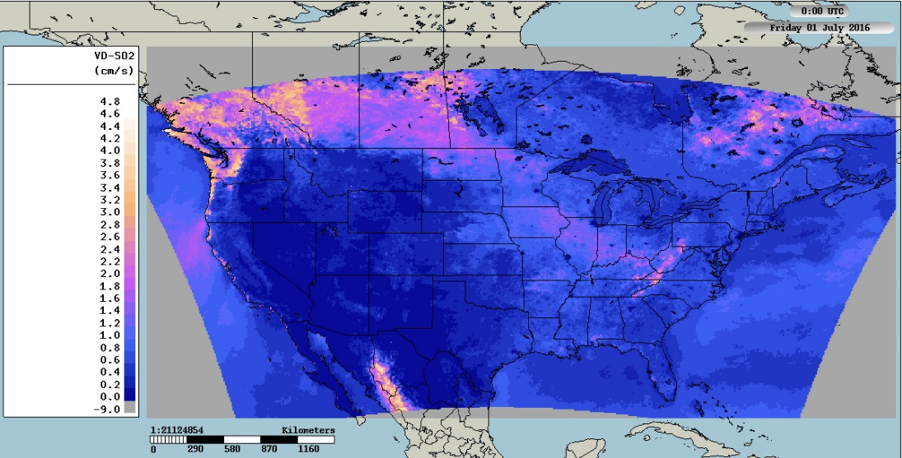
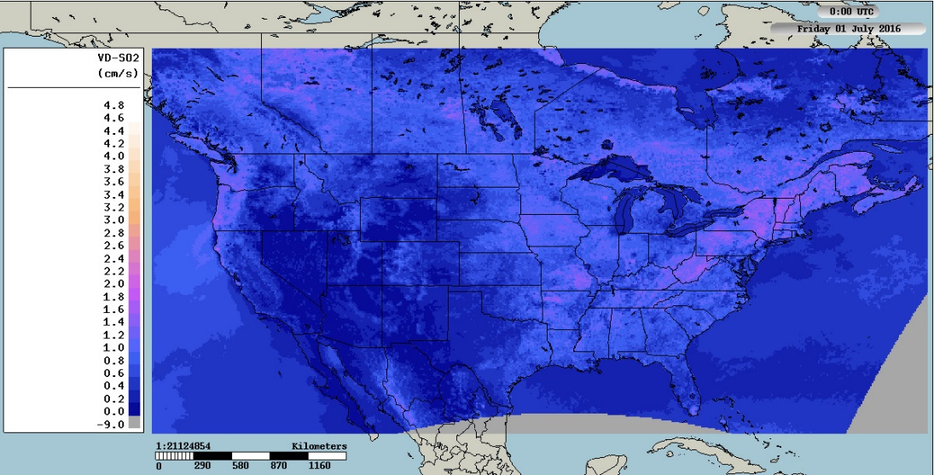
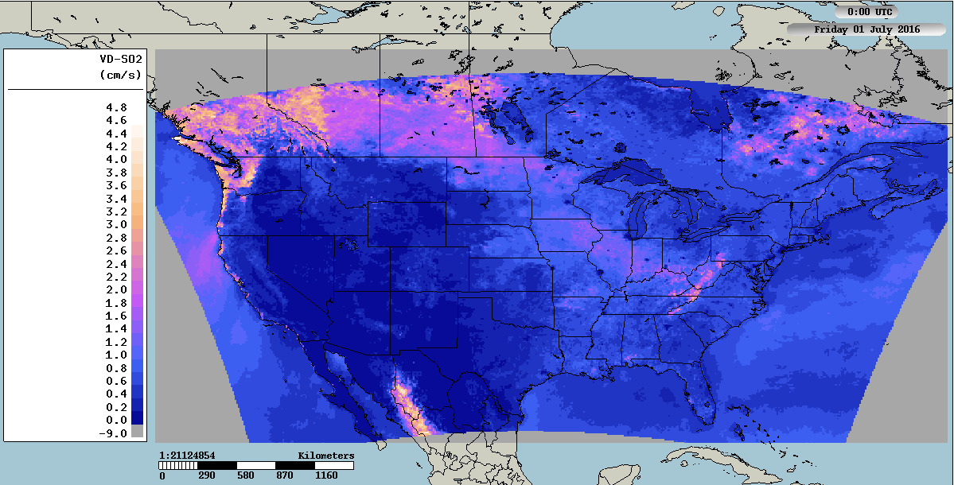
An Example: hot off the press…
A Comparison of CMAQ/M3DRY and GEM-MACH (research configuration aka “BaseCase”)
Very preliminary results!
Let’s look at SO₂ deposition, as an example. Two models give different values for the July median diurnal SO₂ deposition velocity at 16 UT.
CMAQ/M3DRY
GEM-MACH/BaseCase
CMAQ gets up to 4.6 cm s⁻¹.
GEM-MACH gets up to 2.4 cm s⁻¹.
Why? ➔ This is where the AQMEII4 diagnostics show their power for analysis! ☺
cm s⁻¹

Slide 19
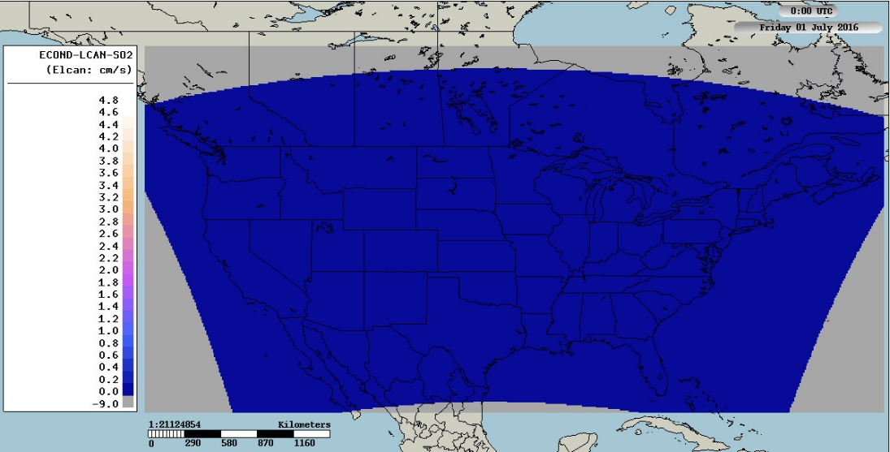
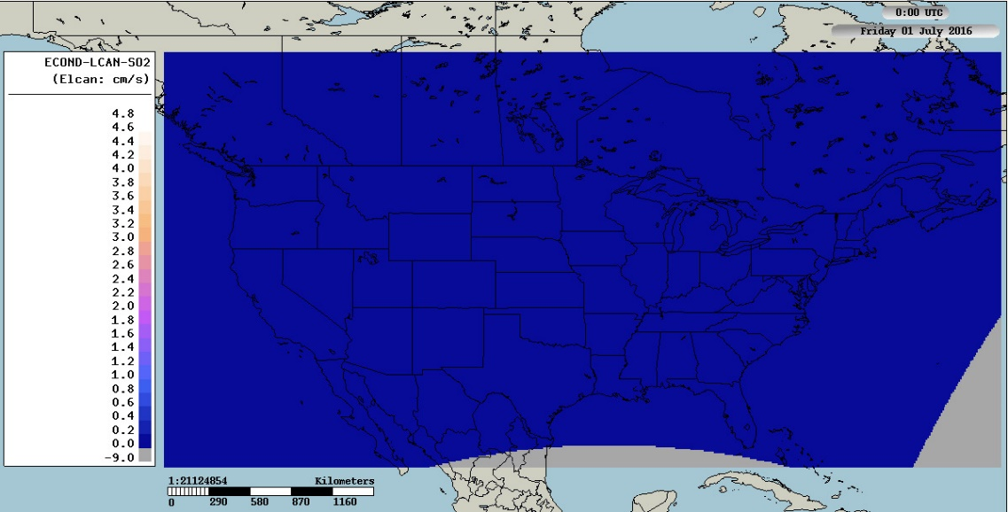
First, we look at Effective Conductances – which deposition pathways control the deposition velocity?
Lower Canopy Pathway
CMAQ/M3DRY
GEM-MACH/BaseCase
cm s⁻¹
The lower canopy pathway is a minor contributor to deposition

Slide 20
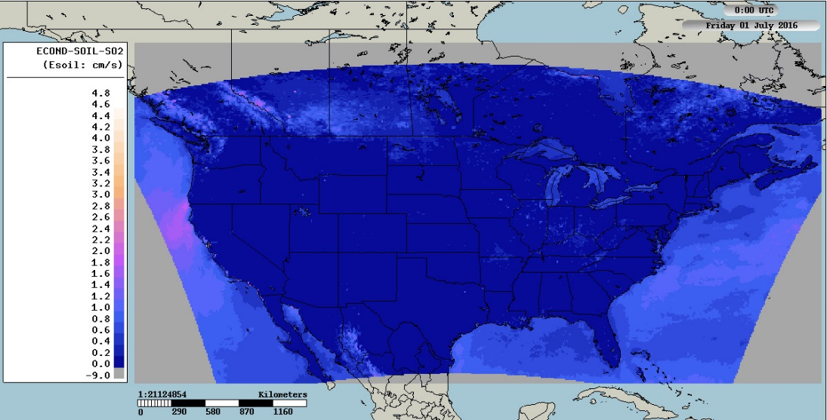
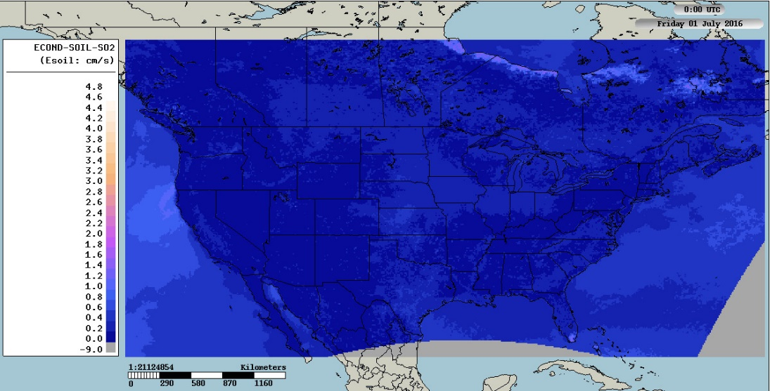
Soil Pathway
CMAQ/M3DRY
GEM-MACH/BaseCase
cm s⁻¹
The soil pathway is also a minor contributor, very similar for both models, a bit higher for CMAQ.

Slide 21
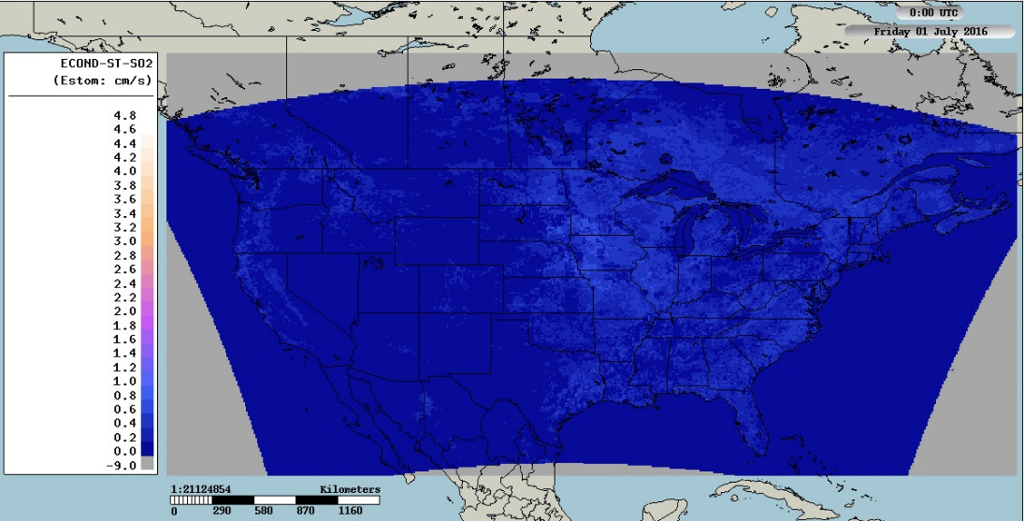
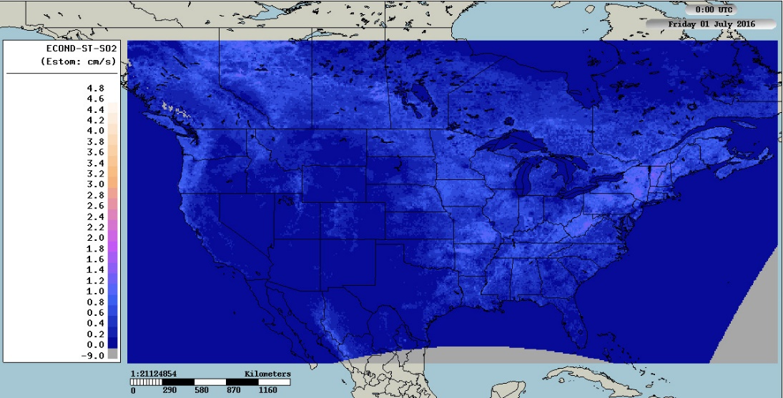
Stomatal pathway
CMAQ/M3DRY
GEM-MACH/BaseCase
cm s⁻¹
Stomatal conductance is the highest contributor to deposition in GEM-MACH at this UT hour; but a relatively minor contributor for CMAQ/M3DRY

Slide 22
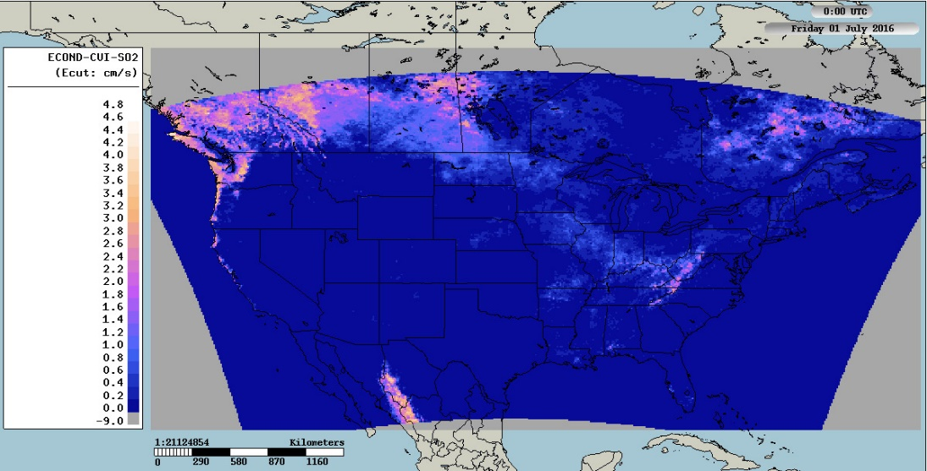
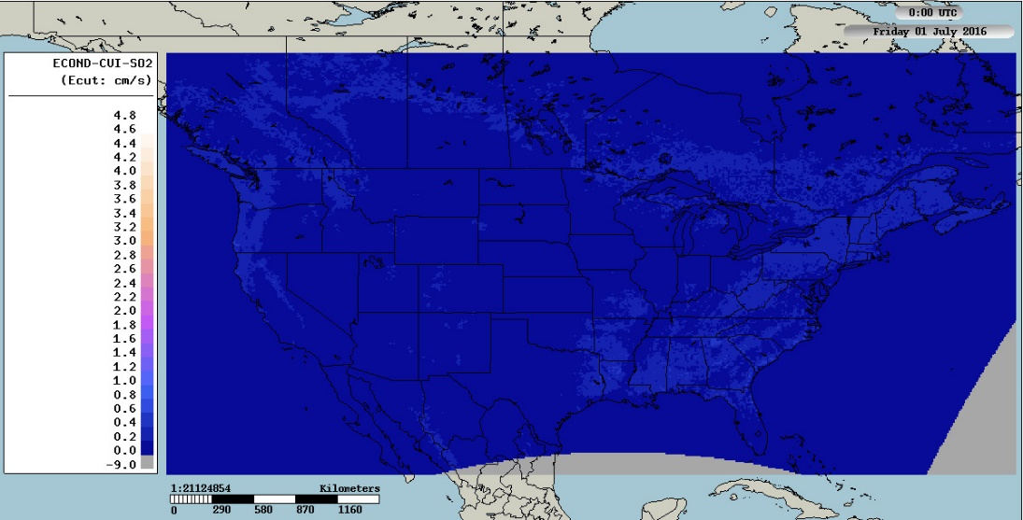
Cuticle Pathway
CMAQ/M3DRY
GEM-MACH/BaseCase
cm s⁻¹
This is the term causing the difference in deposition velocities:
Most of the differences (in terms of contribution to net deposition velocity) between CMAQ/M3DRY and GEM-MACH are in the cuticle resistance term
What’s new here: being able to see the cause of the difference so quickly

Slide 23
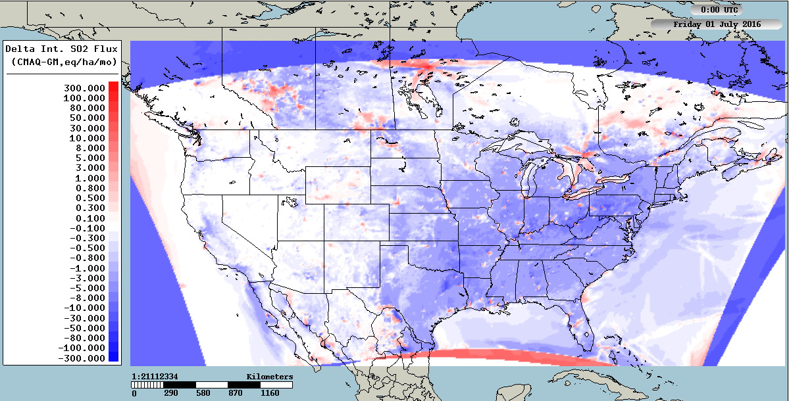
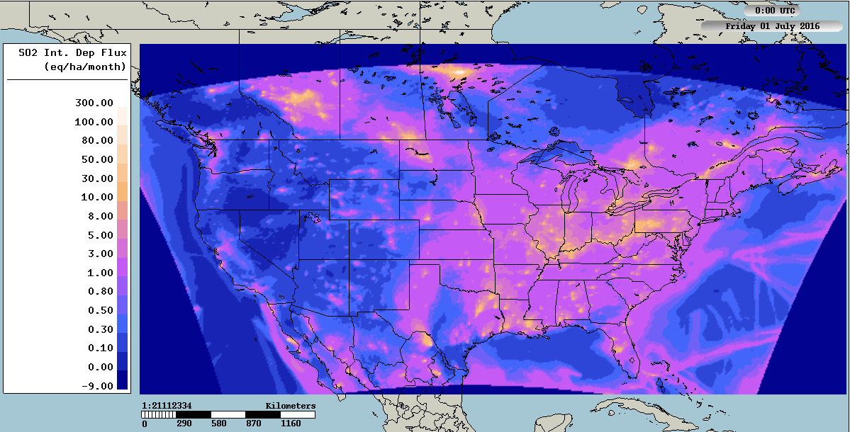
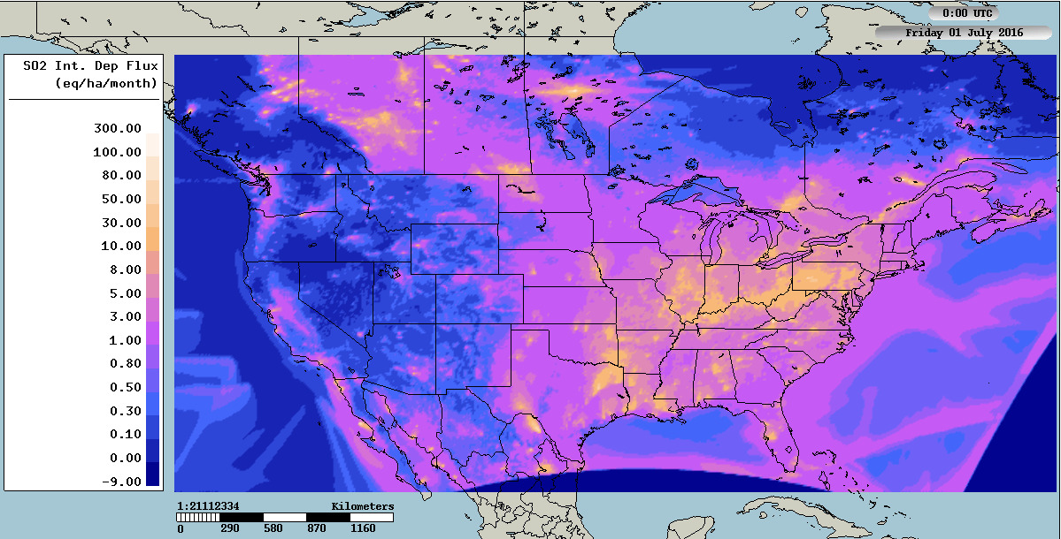
Do these differences affect the time-integrated surface flux of SO₂?
Not so much… only over a much smaller area than might be assumed from the 16UT effective conductances. The July integrated CMAQ deposition flux is actually less than that of GEM-MACH, over much of the domain.
Delta integrated SO₂ flux, July 2016, (CMAQ/M3DRY – GEM-MACH)
CMAQ/M3DRY
GEM-MACH
This is why effective fluxes are important… you get different importance of pathways when local concentration gradients are taken into account. GEM-MACH/BaseCase fluxes are higher than CMAQ/M3DRY in most of the domain.

Slide 24
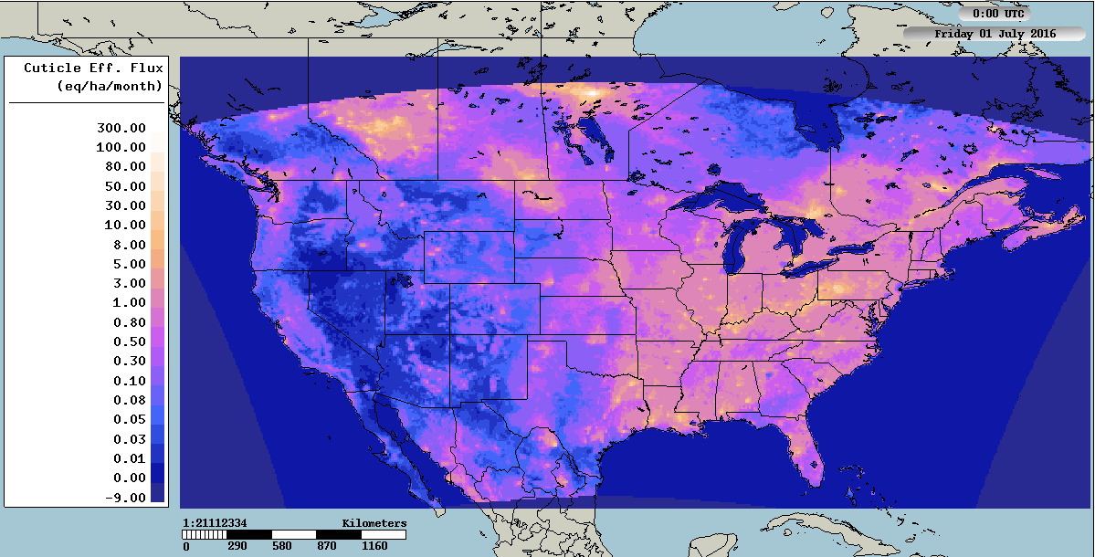
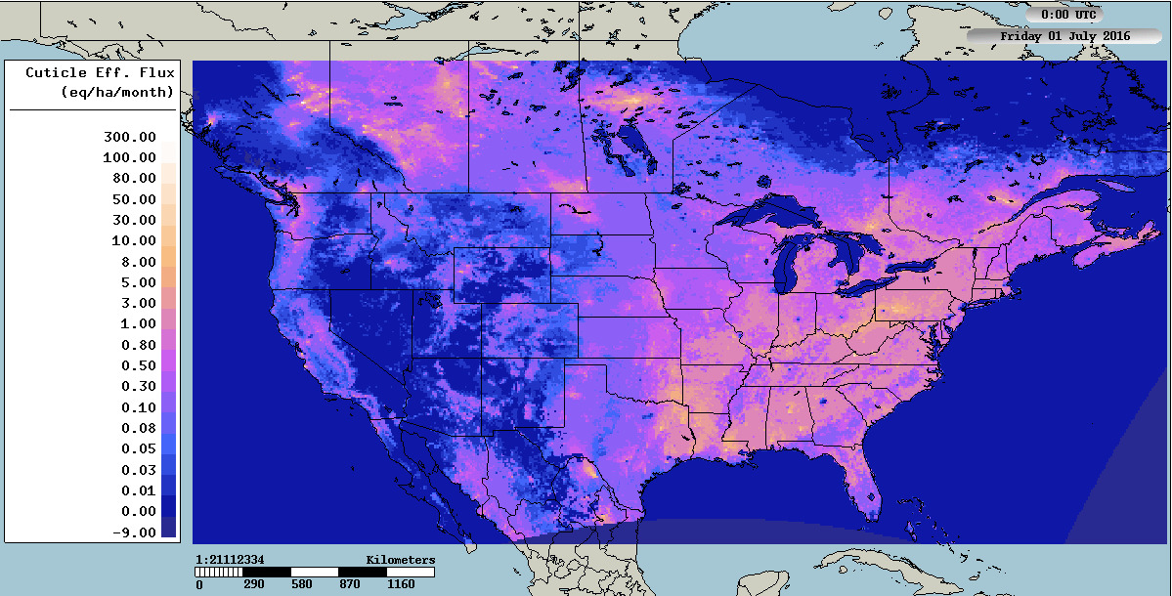
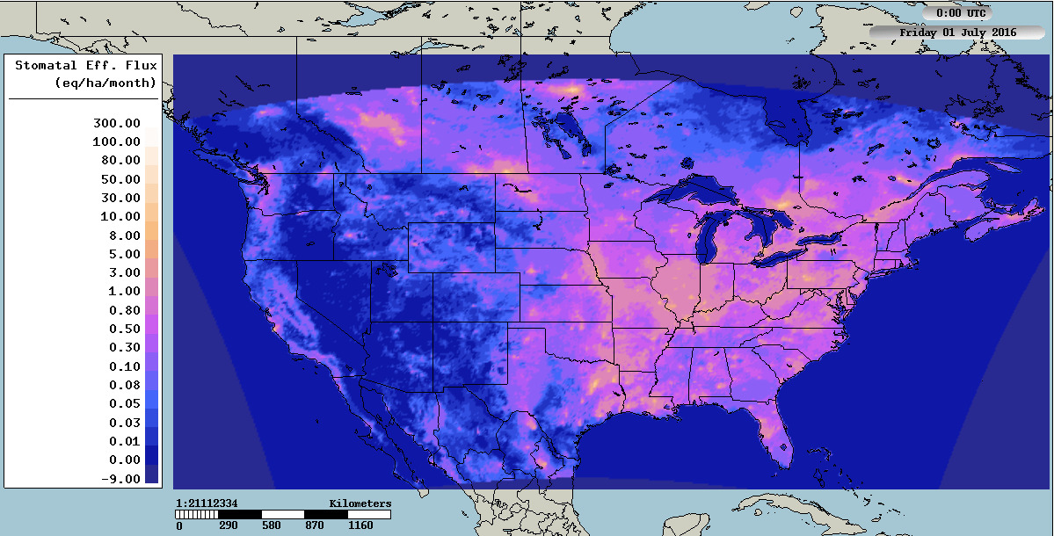
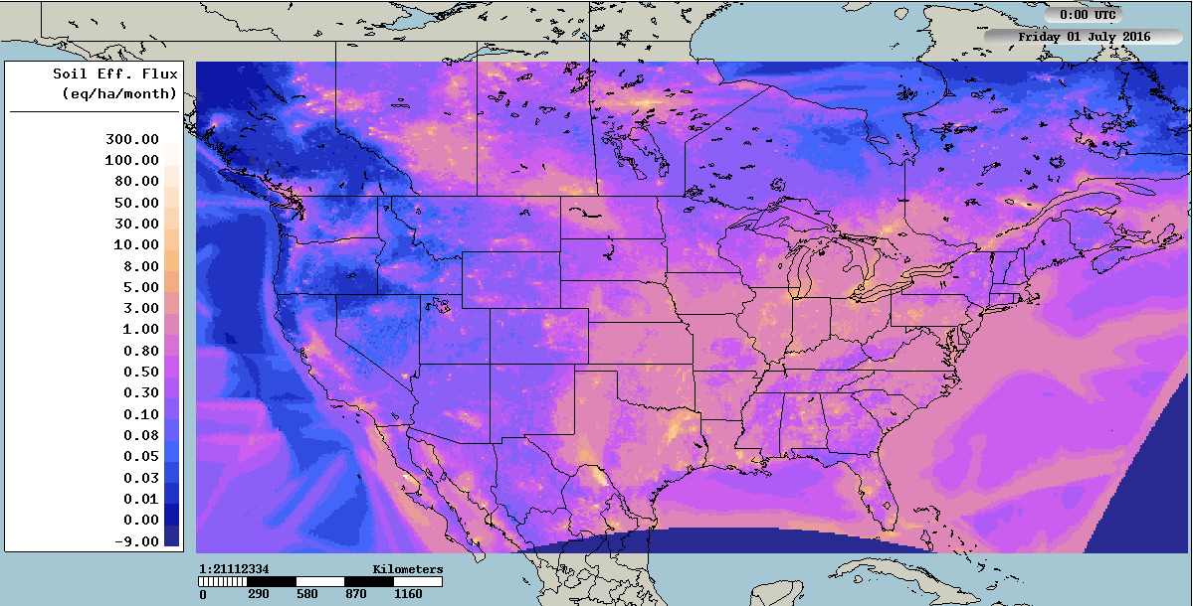
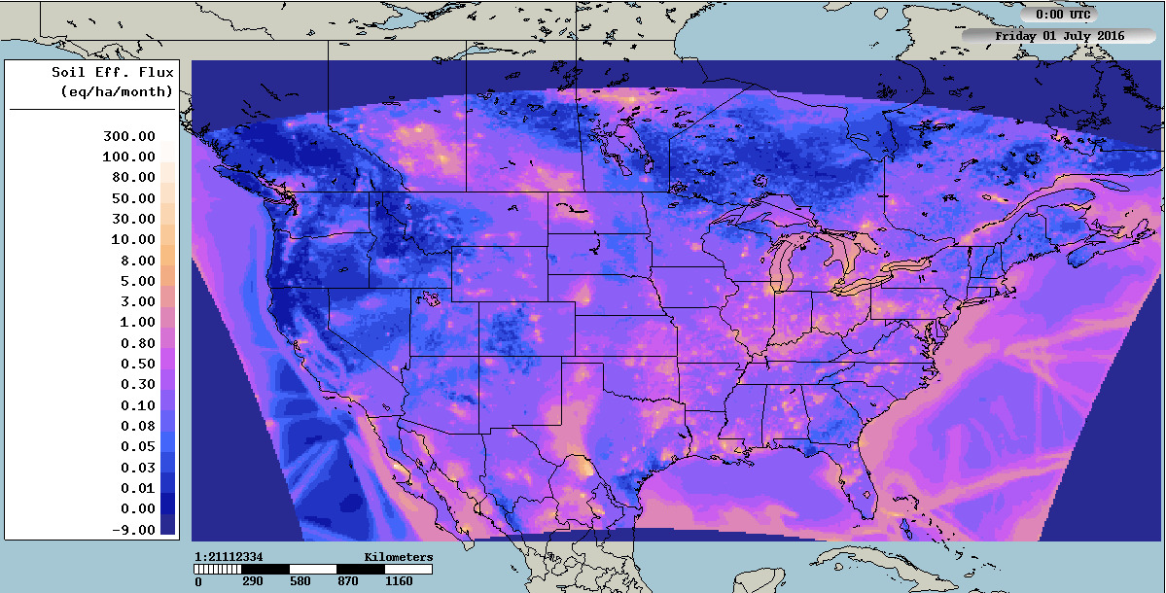
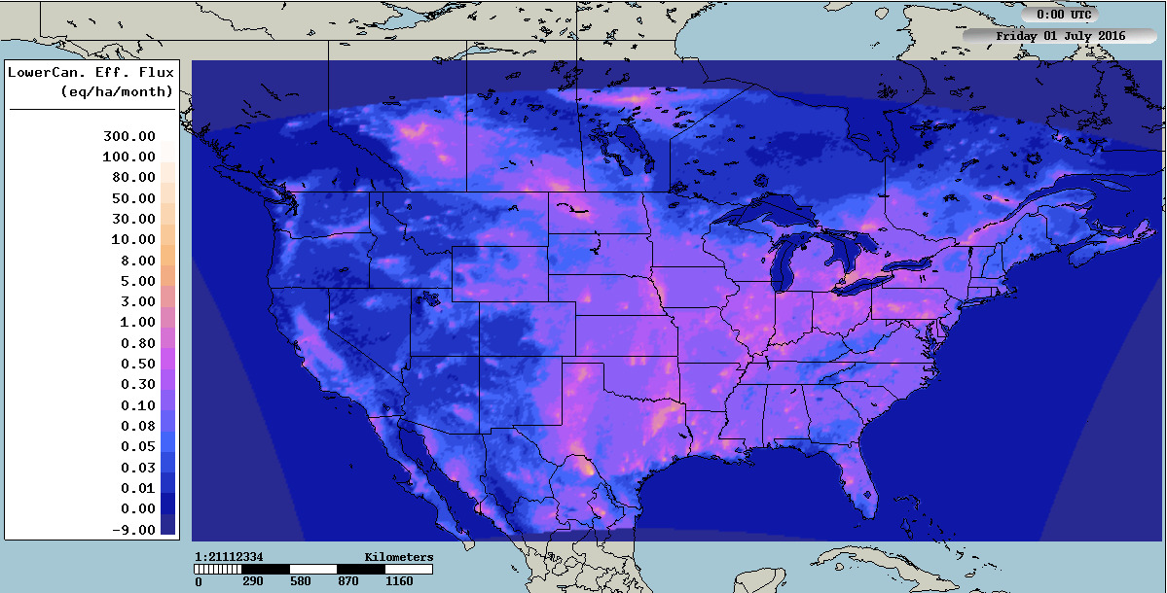
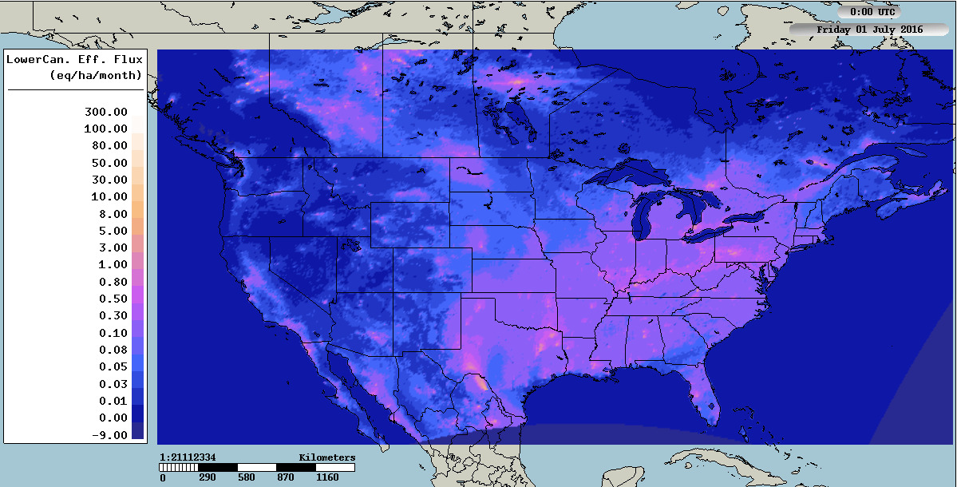
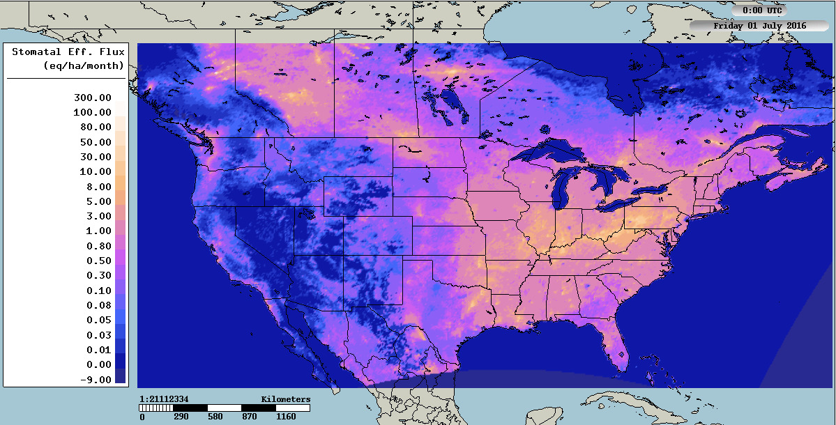
So, next, we check the Effective Fluxes – which deposition pathways control the deposition flux?
CMAQ/M3DRY
GEM-MACH/BaseCase
Lower Canopy Pathway SO₂ Mass Flux, July 2016
Cuticle Pathway SO₂ Mass Flux, July 2016
Stomatal Pathway SO₂ Mass Flux, July 2016
Soil Pathway SO₂ Mass Flux, July 2016
CMAQ/M3DRY < GEM-MACH/BaseCase
CMAQ/M3DRY > GEM-MACH/BaseCase
CMAQ/M3DRY > GEM-MACH/BaseCase
CMAQ/M3DRY < GEM-MACH/BaseCase
The effective fluxes show a somewhat more complicated picture.
Cuticle pathway flux: CMAQ/M3DRY > GEM-MACH/BaseCase
Lower canopy pathway flux: CMAQ/M3DRY > GEM-MACH/BaseCase (though both are small)
Soil pathway flux: CMAQ/M3DRY < GEM-MACH/BaseCase
Stomatal pathway flux: CMAQ/M3DRY < GEM-MACH/BaseCase
The high cuticle effective conductance values do not result in their dominating the deposition flux over the domain.

Slide 25
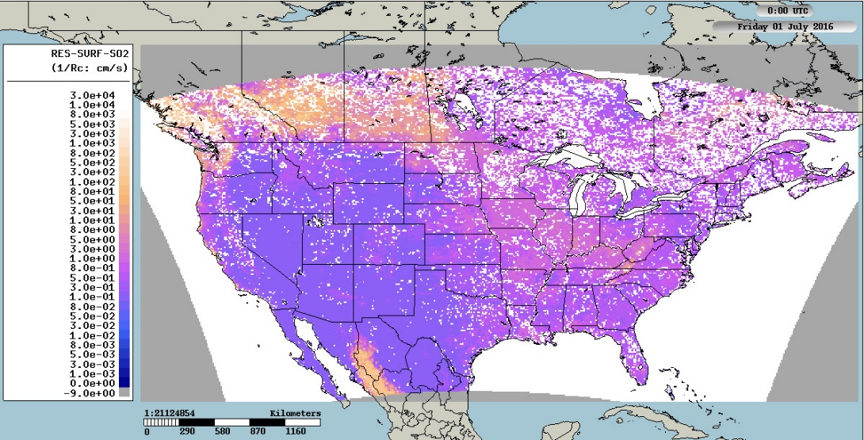
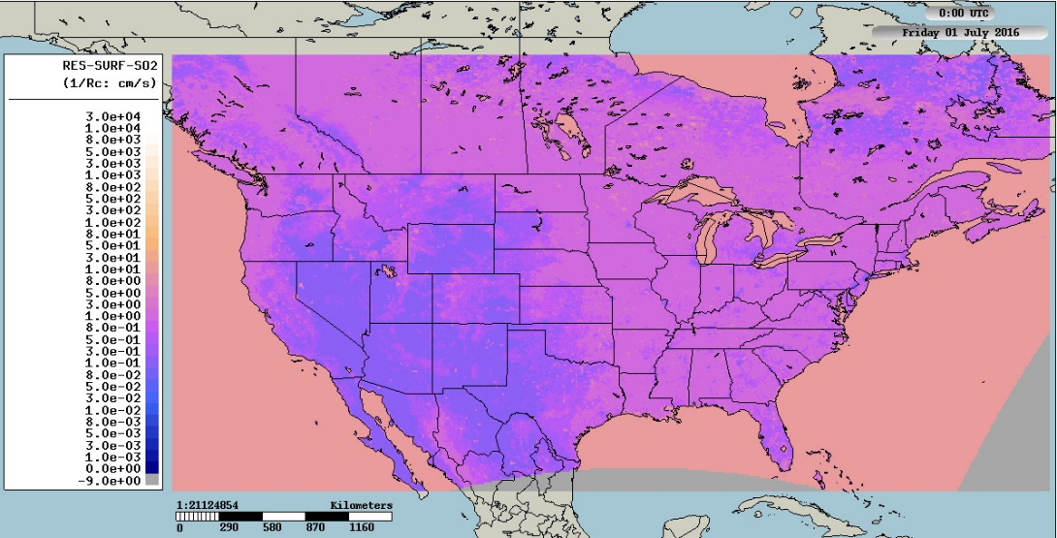
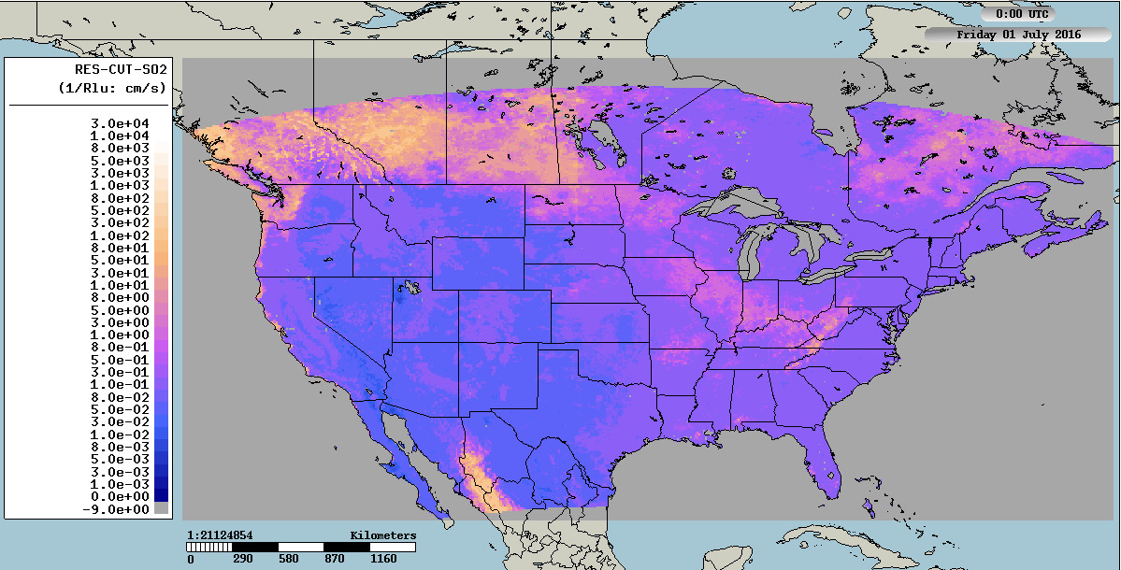
The inverse of the total surface resistance R_{c} also shows some interesting differences at 16 UT
CMAQ/M3DRY
GEM-MACH/BaseCase
cm s⁻¹
Very low resistances (high inverse resistances) in spots in CMAQ simulation:
Water on foliage parameterization is affecting medians ➔ mesophyll resistance, which is small, dominates.
Elsewhere, cuticle resistance is the main contributor to higher SO₂ deposition velocity values at 16 UT.
There are very different minimum resistance values over water, between the two models. CMAQ/M3DRY R_{c} over water << GEM-MACH R_{c}.

Slide 26
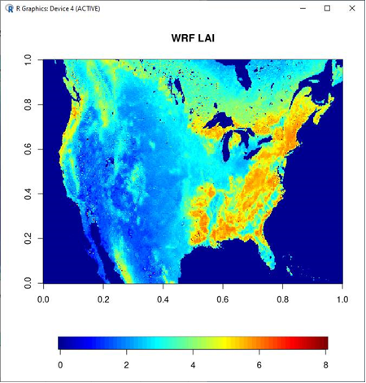
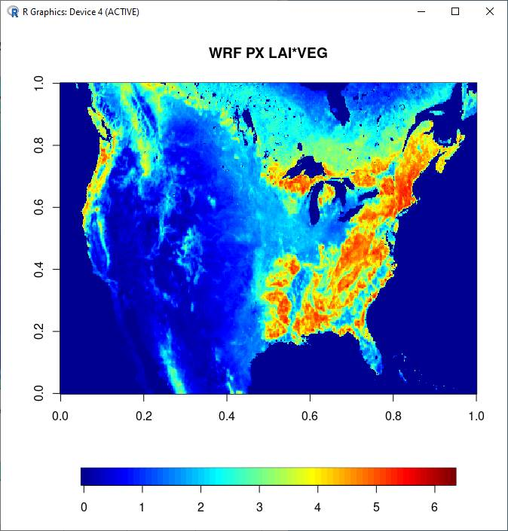
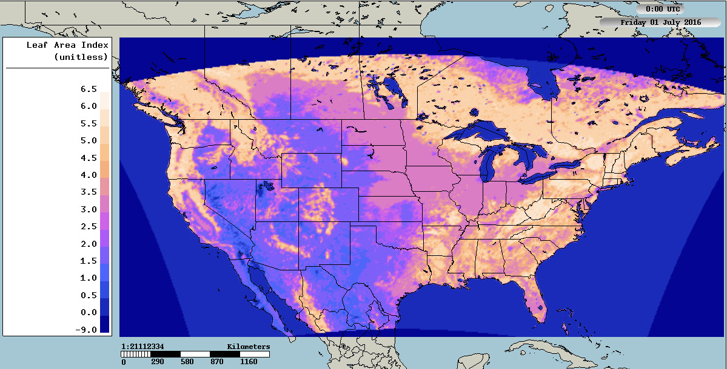
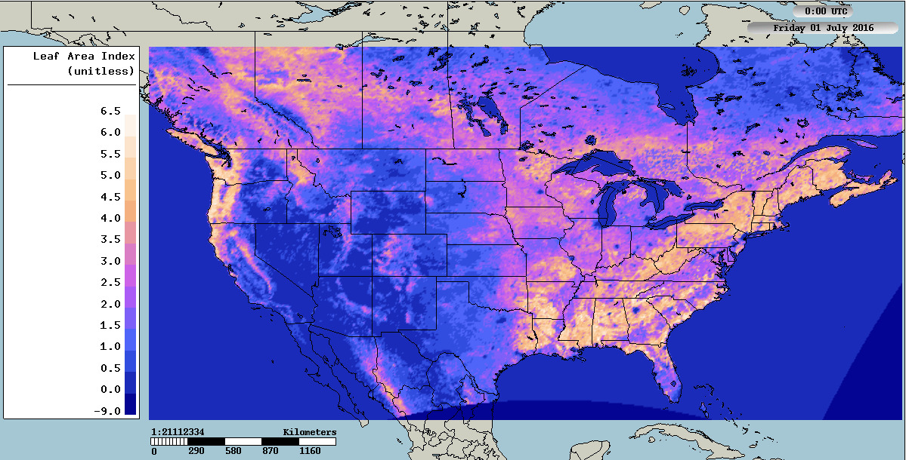
What might be causing the difference in cuticle conductance?
Cuticle conductance is dependent on amount of foliage (Leaf Area Index; LAI) in both models’ parameterizations.
CMAQ/M3DRY July LAI
GEM-MACH July LAI
WRF LAI * VEG fraction – more comparable to GEM-MACH reported LAI
WRF LAI from the same source as CMAQ
CMAQ/M3Dry Leaf Area Index may be higher than in GEM-MACH/BaseCase. We are checking on whether the CMAQ LAI shown here includes scaling land use fractions (making sure the above images are apples and apples).
Which looks more like the GEM-MACH field at right

Slide 27


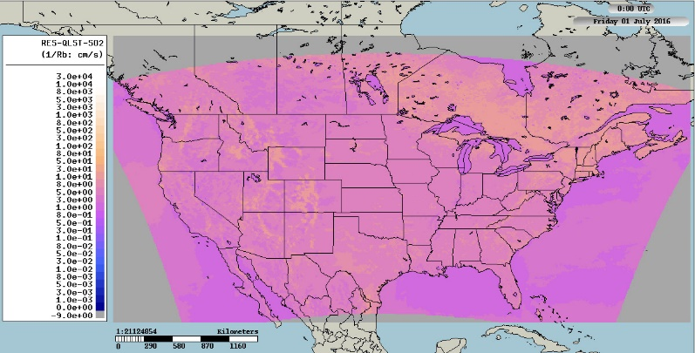
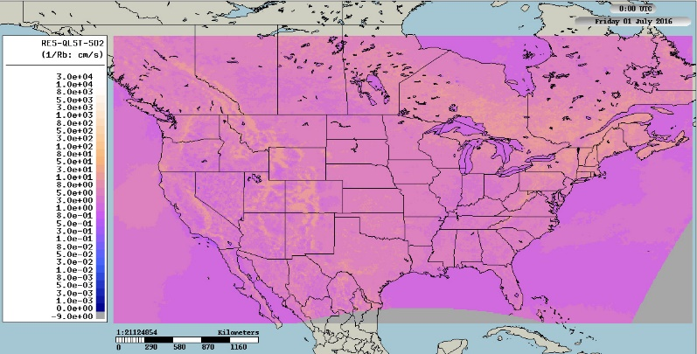
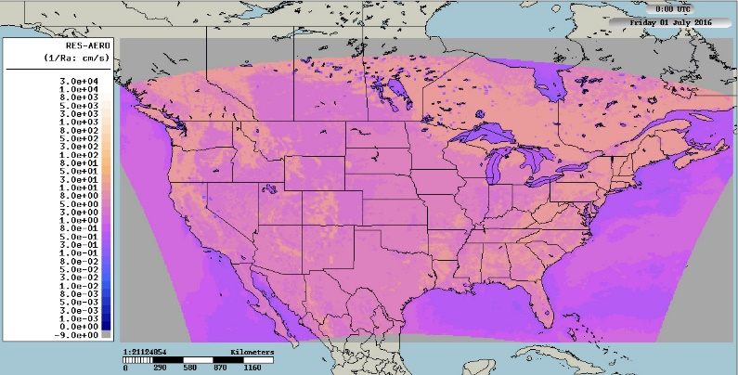
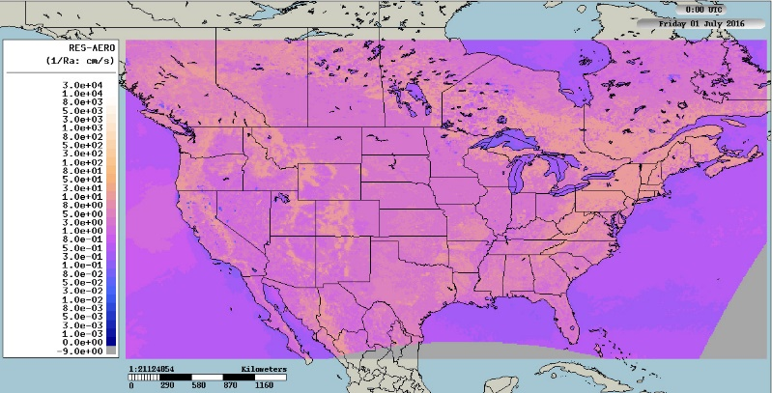
What about R_{a} and R_{b} at 16 UT?
V_{d} = 1/ (R_{a} + R_{b} + R_{c}).
If R_{c} is “small”, R_{a} and R_{b} can become important.
GEM-MACH and CMAQ R_{a} and R_{b} are similar.
1/R_{c} is greater than 1/R_{b}, 1/R_{c} for CMAQ:
R_{c} << R_{b},R_{a}
CMAQ’s deposition velocities are thus controlled by R_{a} and R_{b} in the R_{c} “hotspot” areas”
GEM-MACH: R_{c} > R_{a},R_{b}.
GEM-MACH’s deposition velocities are thus controlled by R_{c}.
1/R_{c}
1/R_{b}
1/R_{a}

Slide 28
Summarizing this example – Dep Velocity
Maximum median SO₂ V_{d} at 16 UT in July 2016: CMAQ/M3DRY: 4.6 cm s⁻¹; GEM-MACH/Base case: 2.2 cm s⁻¹.
The cause of the differences:
Cuticle resistance is lower in CMAQ/M3DRY than GEM-MACH/Base-case, this is due in part to…
Leaf Area Index? TBD: need to do the ratio of the (corrected) CMAQ LAI field to the GEM-MACH field.
Cuticle resistance in CMAQ/M3DRY is sufficiently low that:
The R_{a} and R_{b} terms become the limiting factor for deposition via this pathway.
Most mass (in the area of maximum differences, at 16 UT) is transferred via the cuticle pathway in CMAQ, and via the stomatal pathway in GEM-MACH.

Slide 29
Summarizing this example – Dep Flux
However, the integrated deposition flux and effective fluxes present a more complicated picture.
The region where cuticle resistance dominates the flux is limited in extent.
GEM-MACH/BaseCase soil resistance and stomatal resistance are higher than CMAQ/M3DRY
The result is that GEM-MACH/BaseCase has higher SO₂ deposition fluxes in much of North America than CMAQ.
Note: we relatively quickly (a few days work for two members of the AQMEII4 team) determined:
(1) The specific reason for a large difference between two models’ deposition velocity (cuticle pathway, very locally, and maybe the leaf area index field), and
(2) The specific mechanism by which the difference happens (reduction in cuticle resistance leading to R_{a} and R_{b} dominating deposition).
(3) Other key differences between the models (water-on-foliage parameterizations) have been identified.

Slide 30
What’s next for AQMEII-4: Activity 1
Technical note submitted to ACP
Model inputs are being reformatted to AQMEII4 grids
Extraction and comparison to surface monitoring databases – software to be ported to individual users, processing happens locally (different from past AQMEII’s).
Comparisons and analysis to take place this coming summer and fall; more papers to the special issue by winter 2021 and on through 2022.

Slide 31
What’s next for AQMEII-4: Activity 2
Supersite station data has been collected. Ongoing discussion on data QA/QC
Initial comparisons between some of the point model algorithms and observations has already taken place – more to come.
Activity 2 Technical Note submission to ACP is imminent (within the next month or so).
Comparisons between different box models already underway.
Analysis and paper submission will continue throughout 2021/22 and 2022/23

Slide 32
Disclaimer
All of the work shown here is VERY preliminary, the work and views expressed in this presentation are those of the presenter, and do not necessarily reflect the views or policies of the participants of AQMEII4 or their organizations!

Slide 33
Thanks for your interest in AQMEII-4!
Questions or comments?

Slide 34
Bonus slides (Supplemental Information)

Slide 35

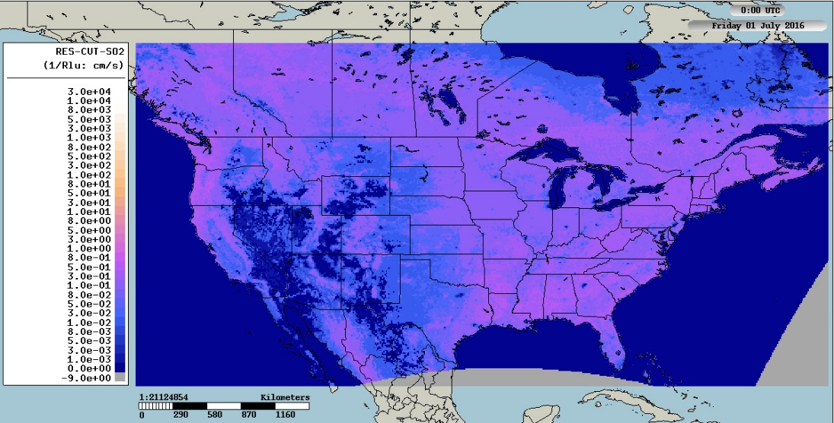
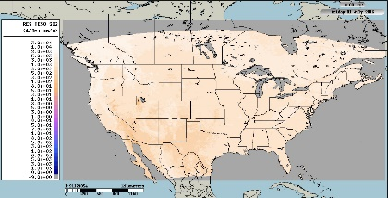
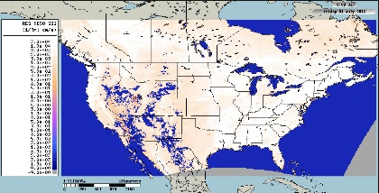
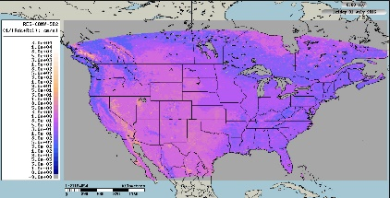
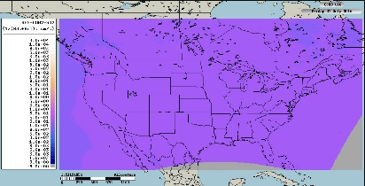
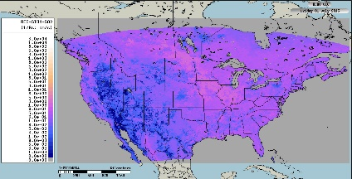
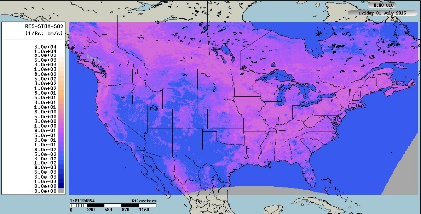
We can look at the inverse of those resistances held in common by most models
Inverse of cuticle resistance being the main one of interest
CMAQ/M3DRY
GEM-MACH
cm s⁻¹
CMAQ/M3DRY
GEM-MACH
1/(Mesophyll Resistance)
CMAQ soil values are higher than GEM-MACH… but this term does not dominate… second after cuticle path
Added in series; stomatal resistance controls this path…
And the contribution is smaller than cuticle path.
1/(Soil Resistance)
+
1/(Stomatal Resistance)

